Slide 1


Case Study on Application of Computer Networks
Online Meetings using
Nuthan Prasad
24SUUBECS1389

Slide 2
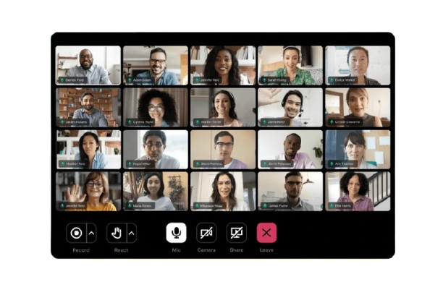
C a t e g o r y :
Communication – Video Conferencing
Google Meet allows people to connect virtually With video, audio, and chat.

Slide 3
REAL TIME EXAMPLE :
Used during online classes and group projects.
Helped maintain learning and teamwork during pandemic.
Saved travel time and provided flexibility.

Slide 4
Advantages:
Fast communication
Global access
Cost-effective
Collaboration tools
Challenges:
Internet dependency
Latency
Privacy/security concerns
Conclusion:
Networks make online meetings possible, proving their importance in modern communication.

Slide 5
Thank You

